Slide 1
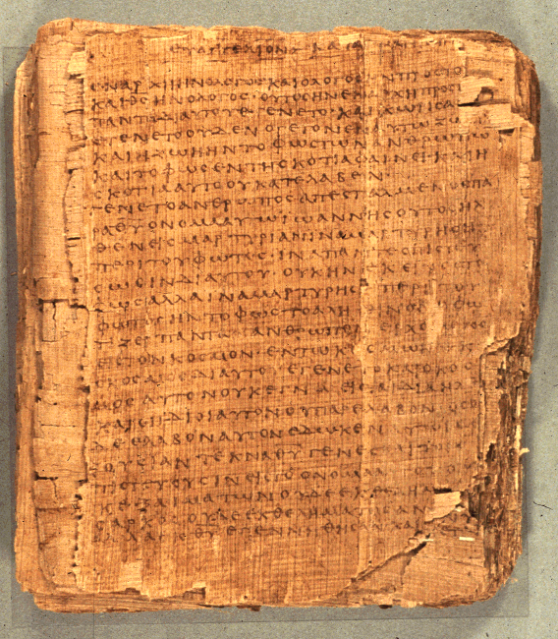
Comprehending the Psalms
Dr. Rodney K. Duke

Slide 2
CLASS 4
Assign:
Daily Journal
Assign. #6. Outline AND diagram the balanced thought structure of Ps 24.
Assign. #7. Discover the various roles of the Israelite priests. (Long reading on priests, if interested)
Day Objectives:
Explain the cultic symbol system behind the sacrificial system.
Learn how to diagram “balanced thought structures.”
Develop skill outlining psalm types.

Slide 3
REVIEW: IDENTIFYING TYPES OF PSALMS (Assign, #2)
Psalms of Petition/Lamant (Pss 74, 79)
Intention: Get God to act
Addressed to God
Mood shifts from lament/despair to confidence
Time orientation: present
Psalms of Declarative Praise/Thanksigiving (Pss 34, 116)
Intention: Thanking God
Addressee: God, general audience, sometimes oneself
Mood consistent: upbeat
Time orientation: reflects back on past
Psalms of Descriptive Praise/Hymns (Pss 33, 113)
Intention: Praise God in general
Addressed to general audience
Mood consistent: upbeat
Time orientation: rather atemporal
Note: Two major naming systems used by commentators.

Slide 4
BACKGROUND ON PSALMS
Theological Basis and/or Implications
Each psalm has own distinct message; but some generalizations:
A. Petitions:
1. God is to be approached boldly, with complete openness
2. Even in despair, the psalmist expressed trust
B. Thanksgivings:
1. God is to be thanked by testimony before the community
in celebration
2. God is experientially knowable
3. Faith in God who acts on their behalf
C. Hymns:
1. God is worthy of praise
2. God, who is majestic and sovereign, graciously
condescends to care for those who trust God

Slide 5
SYMBOL SYSTEM OF THE PSALMS
  HOLINESS
  SACRIFICIAL SYSTEM
  PRIESTS (see PDF link at course site)

Slide 6
Holiness & Sacrifices
(relates to Handouts, pp. 16-17)
What are some “unclean” foods in our culture that might be eaten in other cultures? Why are they “unclean” in our culture?
What are some “unclean”/unacceptable behaviors in our culture that might be acceptable in other cultures? Why are they unacceptable?
For the Israelites fish were “clean” but lobsters were “unclean.” What would be a possible explanation?
For Israel blood from a cut was “clean” but menstrual blood was “unclean.” What would be a possible explanation?

Slide 7
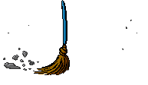
Holiness & Sacrifices
a. Purity system and Holiness system
Purity: clean (life, order) vs. unclean (death, chaos)
Holiness: holy (set apart for sacred use) vs. common
Normal (clean and common) vs “Contagious” (unclean, holy)
Holiness has “gradations” (examples on next slide)
b. Purification:
Permitted impurity (not sin) vs. unpermitted
Unpermitted impurity polluted God’s “dwelling place”

Slide 8
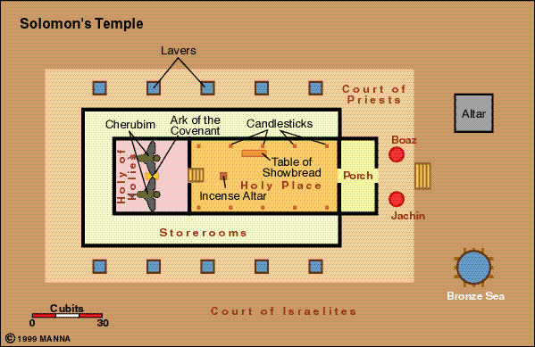

Slide 9
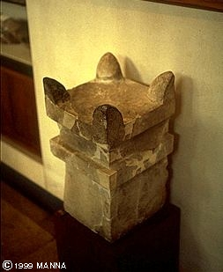
Holiness & Sacrifices
c. Sacrificial system:
Gifts or gestures of obedience, but NOT food or magical manipulation
Blood (Lev. 17:10-14): symbol of life
A couple of types:
“Purgation”: cleansed God’s dwelling
“Well-being”: feast (“Thanks offering”; (Todah: thanks; thanks offering)
Horned altar from Megiddo

Slide 10
Assignment #6
6. Objective: Develop skill of identifying the “balanced thought structures” (parallelism) of Hebrew poetry.
In the handout, study the pages on “Balanced Thought Structures.” (pp. 24-25)
Using the handout translation of Psalm 24 (p. 27), outline major parts of the psalm. (Come up with your own headings. This psalm does not fit one of the 3 major types.)
Using the handout translation of Psalm 24 (p. 27), diagram with letters and slash lines, verse-by-verse, each of the balanced units in Psalm 24.

Slide 11
Purposes of Creating an Outline
I. Main summary
A. Summary
1. sum
2. sum
B. Summary
II. Main summary
Etc.
1) Outline structure: gives overview of flow of thought / syntactic level
2) Outline labels: function as summaries & give overview of content / semantic level

